Slide 1
SinGAN:
Learning a Generative Model from a Single Natural Image
Team #6
Chun Cheng Kaiyan Xu
Hui Zheng
Source:
Tamar Rott Shaham, Tali Dekel, and Tomer Michaeli. Singan: Learning a generative model from a single natural image. In Computer Vision (ICCV), IEEE International Conference on, 2019.
REFERENCES:
[1] Zhang J., Bargal S. A., Lin Z., Brandt J., Shen X., & Sclaroff S. (2018). Top-down neural attention by excitation backprop – International Journal of Computer Vision, 126(10), 1084-1102.
[2] Bargal S. A.*, Zunino A.*, Kim D., Zhang J., Murino V. and Sclaroff S. (2018). Excitation Backprop for RNNs – Proc. IEEE Conf. on Computer Vision and Pattern Recognition (CVPR).
[3] Zunino A.*, Bargal S. A.*, Morerio P., Zhang J., Sclaroff S., & Murino V. (2018). Excitation Dropout: Encouraging Plasticity in Deep Neural Networks – arXiv preprint arXiv:1805.09092.

Slide 2

Problem targeting & Motivation
Large data set of images are generally required
Notes:
Generative Adversarial Networks(GAN)
requires large data set of images
and usually restrict to single kind of images
like characters, human portrait, mountains ets
Is it possible to train a GAN with single image and how good we can achieve.

Slide 3
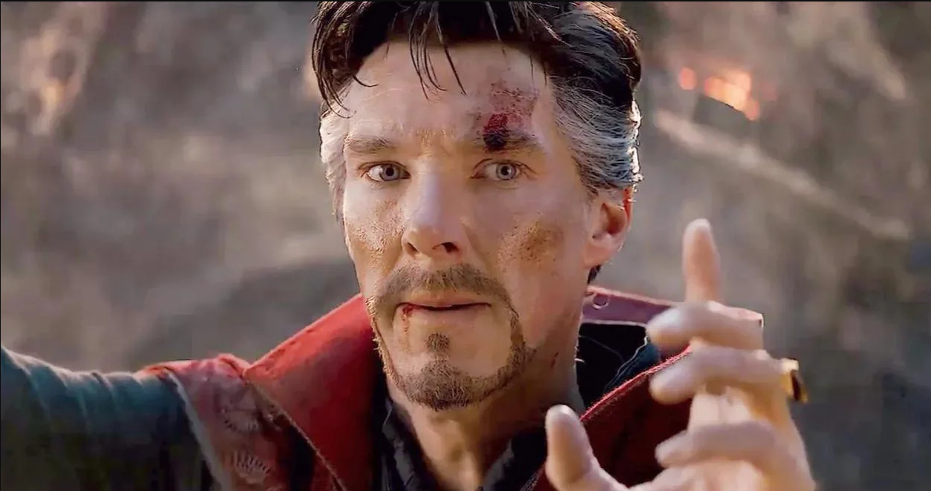
Goal
Learn from single natural image
Avengers: Endgame, Directors: Anthony Russo, Joe Russo
Notes:
The goal for this research is to train a GAN that learning from single natural image, and achieve high quality outputs

Slide 4
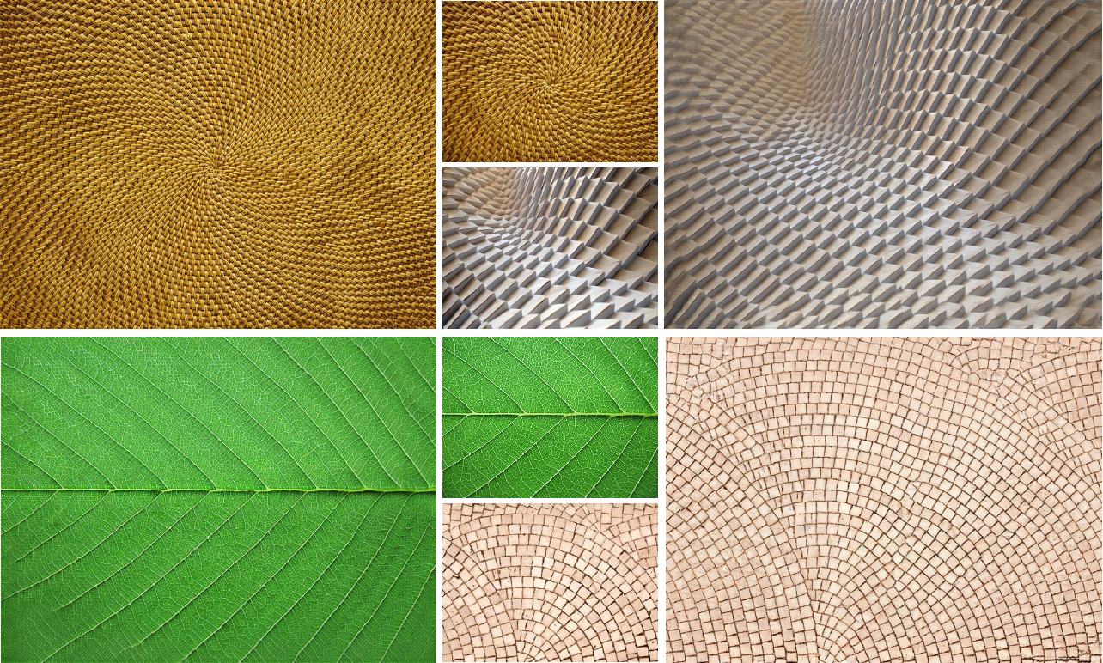
Related Works
Texture Expansion 2018
Zhou, Y., Zhu, Z., Bai, X., Lischinski, D., Cohen-Or, D., & Huang, H. (2018). Non-Stationary Texture Synthesis by Adversarial Expansion. ArXiv:1805.04487 [Cs]. https://arxiv.org/abs/1805.04487
‌
Notes:
Training GAN with single image already come into play for a while.
In 2018, there’s a research about texture expansion. It relies on single texture image, and achieve high quality picture expansion by generating more texture to fill up the image.

Slide 5
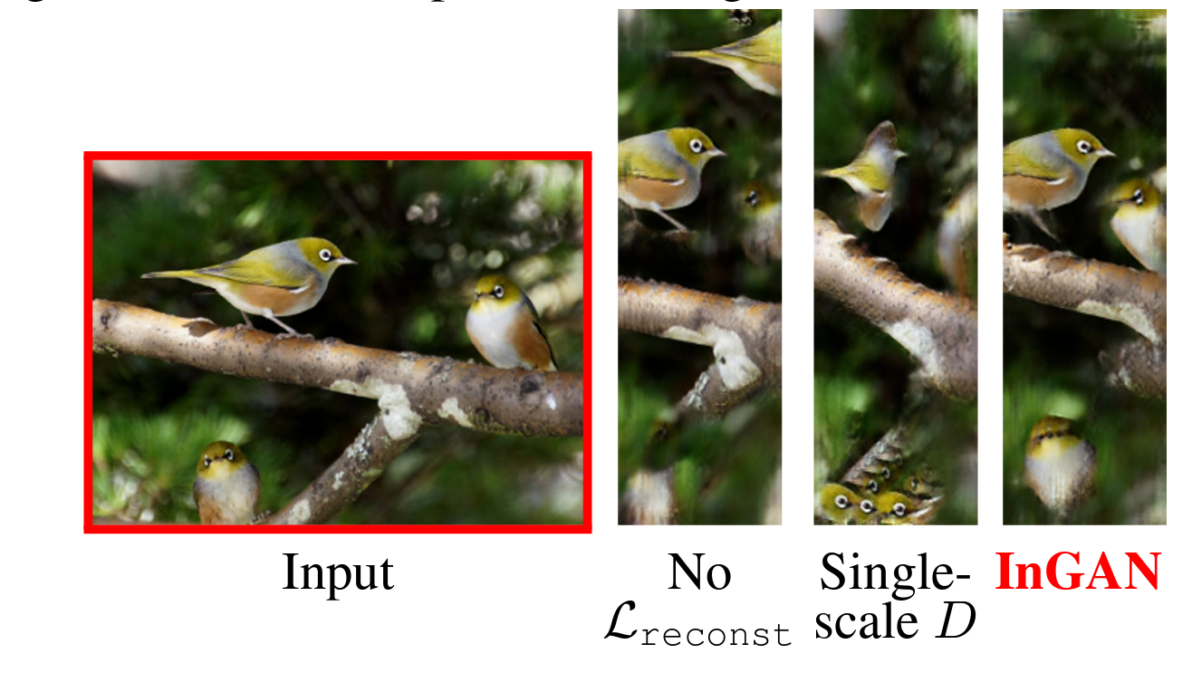
Related Works
Single natural image Retargeting
InGAN-Internal GAN 2019
Shocher, A., Bagon, S., Isola, P., & Irani, M. (n.d.). InGAN: Capturing and Retargeting the “DNA” of a Natural Image. Retrieved August 10, 2022, from https://openaccess.thecvf.com/content_ICCV_2019/papers/Shocher_InGAN_Capturing_and_Retargeting_the_DNA_of_a_Natural_Image_ICCV_2019_paper.pdf
‌
Notes:
By 2019, there’s another research which based on single natural image and achieve retargeting. Retargeting at here can be understand by two aspects, the first parts is expanding, the second part is shrinking. Both action should not tilt, scale or change the major target in the image. A good example you can see here, the input is a picture with three birds in it, and on the right hand side, when we we change the width of the image, instead of squiz the picture, the output from InGAN just put three birds moves closer to each other.

Slide 6
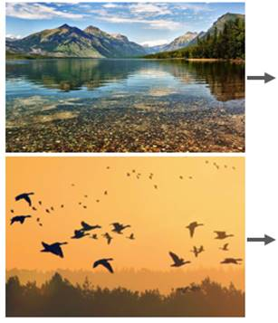
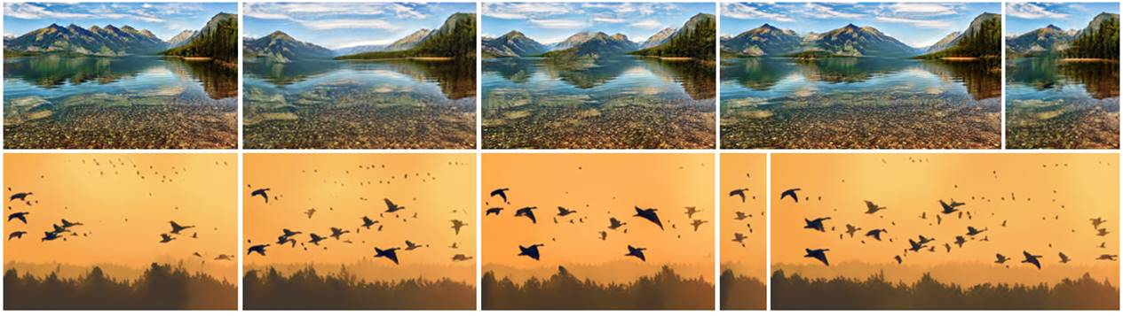
Main Reference Work
SinGAN: Learning a Generative Model from a Single Natural Image
ICCV 2019 Best paper award (Marr prize)
Shaham, T., Dekel, T., Research, G., & Michaeli, T. (n.d.). SinGAN: Learning a Generative Model from a Single Natural Image. Retrieved August 10, 2022, from https://openaccess.thecvf.com/content_ICCV_2019/papers/Shaham_SinGAN_Learning_a_Generative_Model_From_a_Single_Natural_Image_ICCV_2019_paper.pdf
‌
Notes:
At 2019 we have a better solution, SinGAN. Why it’s better? First SinGAN is unconditional veras InGAN is conditional. Secondly application wise, SinGAN can also achieve highper resolution, harmonization. We can also create animation from single image.
We show that the internal statistics of patches within a single natural image typically carry enough information for learning a powerful generative model. Once trained, SinGAN can produce diverse high quality image samples (of arbitrary dimensions), which semantically resemble the training image, yet contain new object configurations and structures.

Slide 7





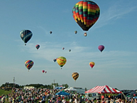

Method
Only one training image
Detect distribution of patches in a single image
Uses different scales of a single image
Tamar Rott Shaham, Tali Dekel, and Tomer Michaeli. Singan: Learning a generative model from a single natural image. In Computer Vision (ICCV), IEEE International Conference on, 2019.
Real Scale

Slide 8
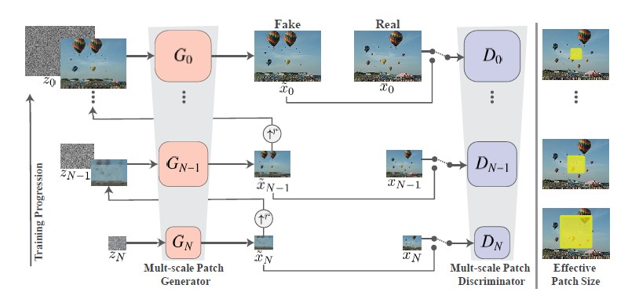
Architecture
Multi-scale Pipeline
Tamar Rott Shaham, Tali Dekel, and Tomer Michaeli. Singan: Learning a generative model from a single natural image. In Computer Vision (ICCV), IEEE International Conference on, 2019.

Slide 9
Architecture Details
Patch-GANs (Markovian discriminator)
Fully convolutional net
3x3 kernels
Start with 32 kernels, number increases every 4 scales
LeakyReLU
Tamar Rott Shaham, Tali Dekel, and Tomer Michaeli. Singan: Learning a generative model from a single natural image. In Computer Vision (ICCV), IEEE International Conference on, 2019.

Slide 10
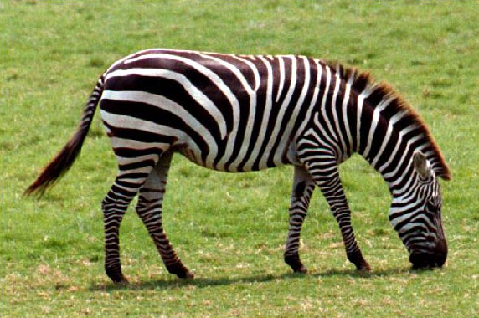
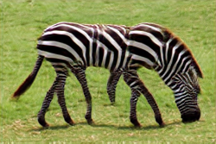
Effect of Scales
Training Image Start generation at G_{N}
Tamar Rott Shaham, Tali Dekel, and Tomer Michaeli. Singan: Learning a generative model from a single natural image. In Computer Vision (ICCV), IEEE International Conference on, 2019.

Slide 11
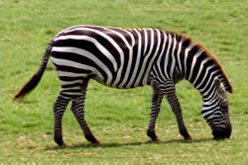
Effect of Scales
Training Image Start generation at G_{N-1}
Tamar Rott Shaham, Tali Dekel, and Tomer Michaeli. Singan: Learning a generative model from a single natural image. In Computer Vision (ICCV), IEEE International Conference on, 2019.

Slide 12
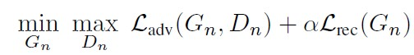
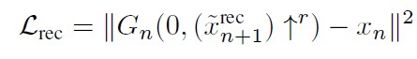
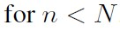
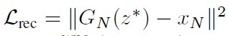
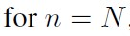
Training Details
Total Loss
Reconstruction Loss
Adversarial Loss
Tamar Rott Shaham, Tali Dekel, and Tomer Michaeli. Singan: Learning a generative model from a single natural image. In Computer Vision (ICCV), IEEE International Conference on, 2019.

Slide 13
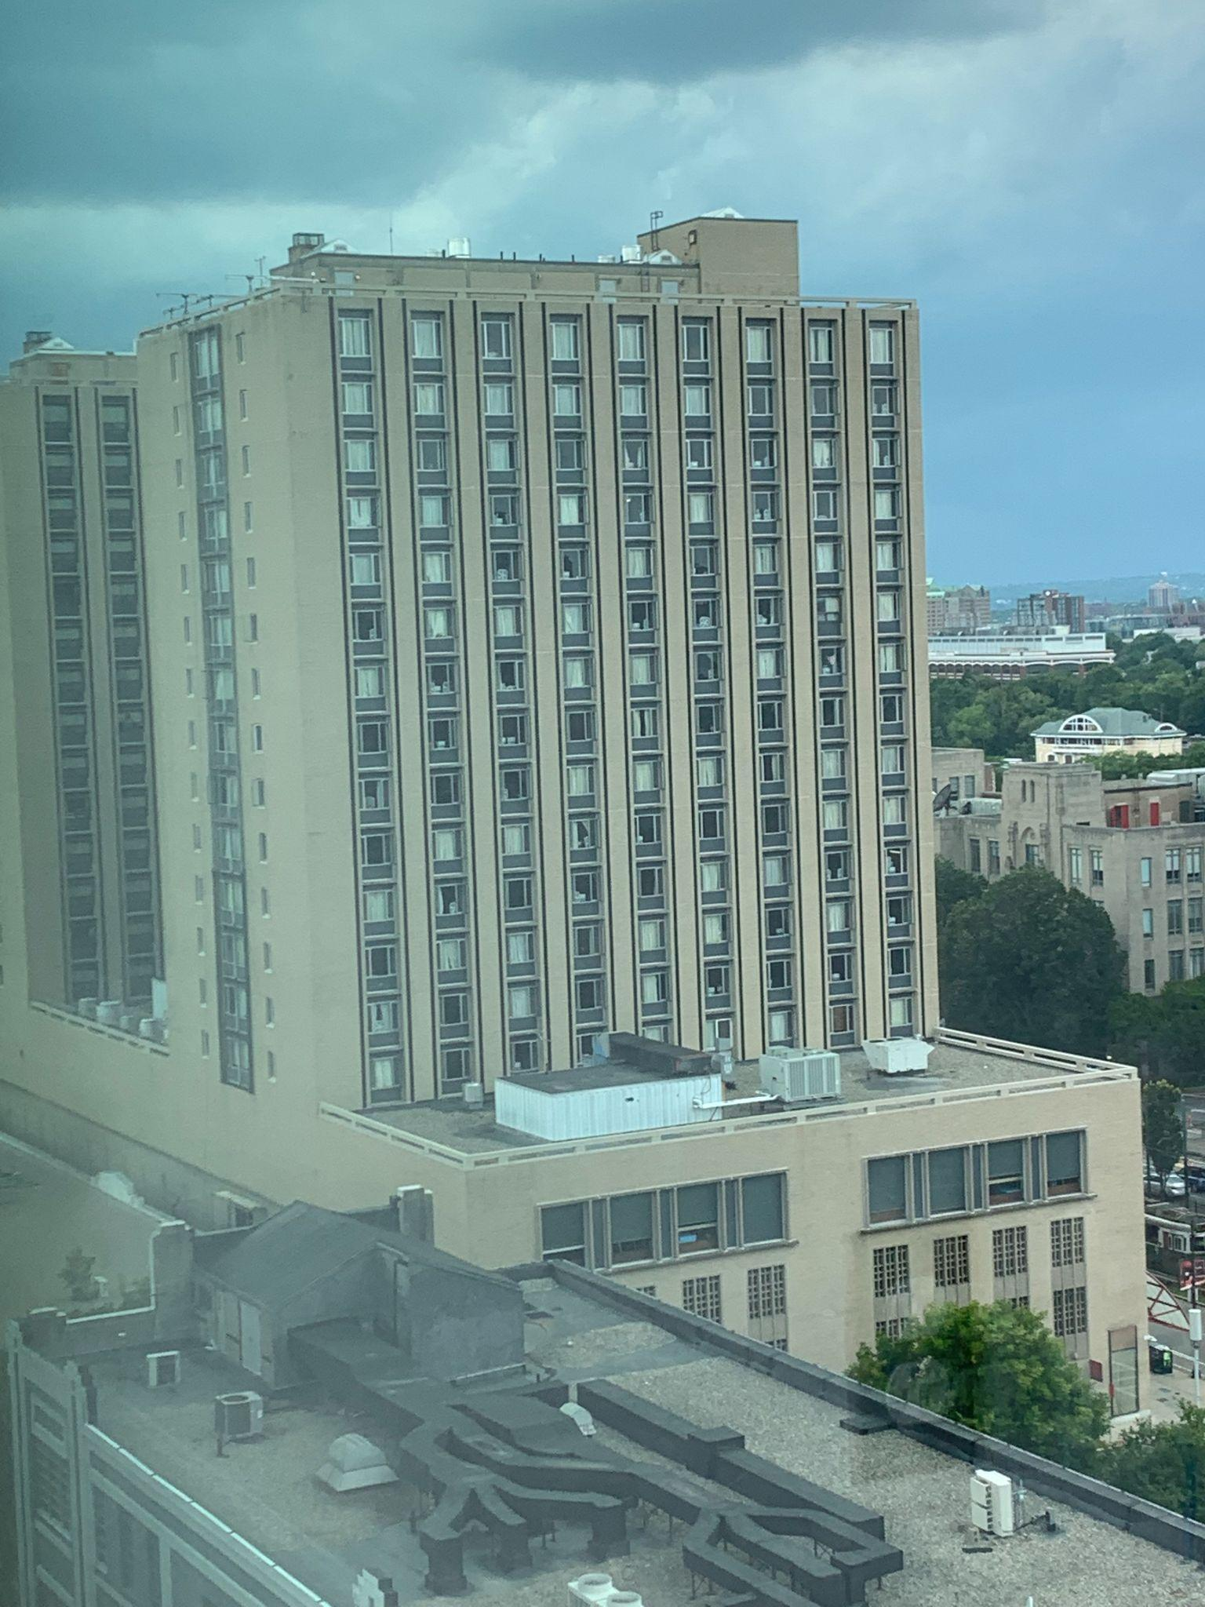
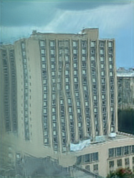
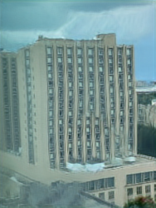
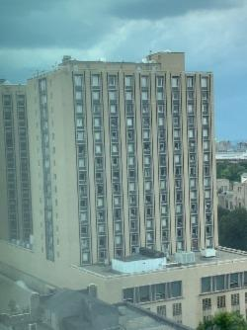
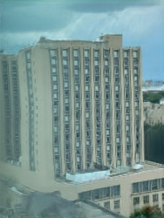
Experimental Setup
cuda/10.1 python3/3.6.9 pytorch/1.3
…
188*250
50
Notes:
limited by optimization scheme
we resized the training image to maximal dimension 250px, so it is correspondent to researcher’s image and guarantees training speed
50 random output

Slide 14
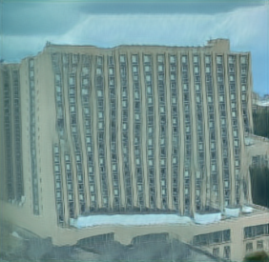
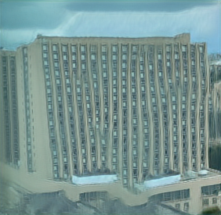
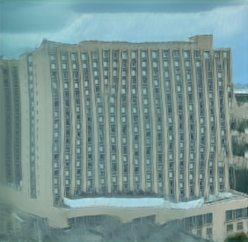
Experimental Setup
cuda/10.1 python3/3.6.9 pytorch/1.3
…
…
50
50
Notes:
50 images same dimension with input image, if we want to learn from finer scale or resize the output, we implement after getting 50 random outputs; here are some wider warren towers with more windows

Slide 15
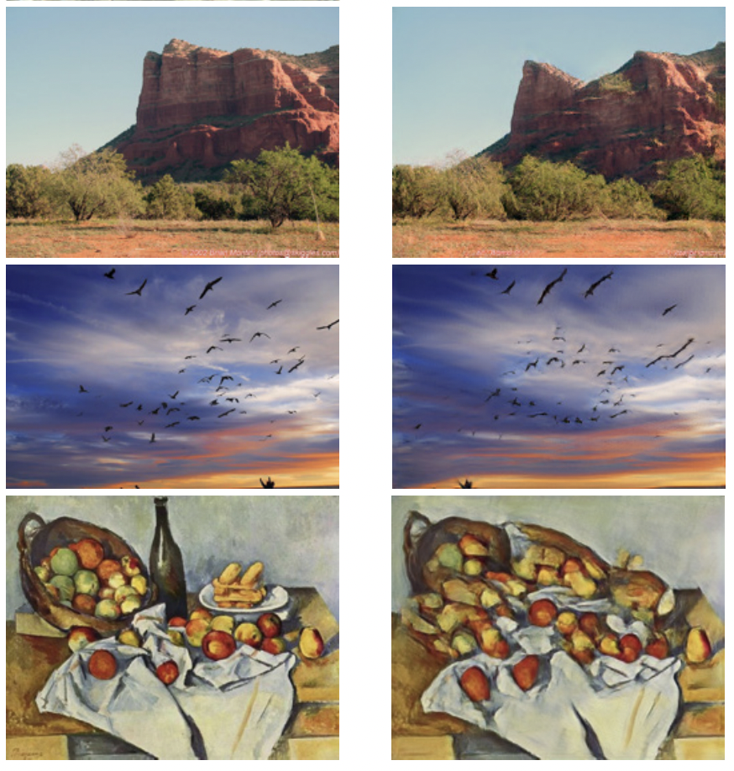
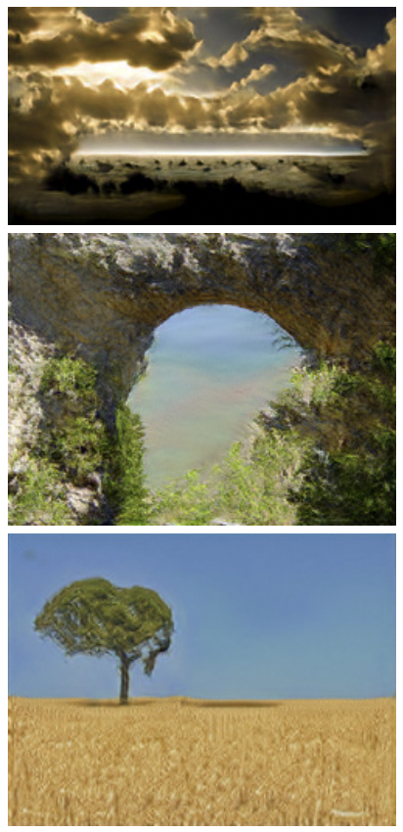
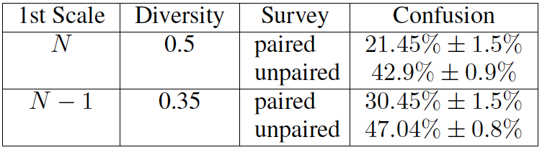
Quantitative Evaluation - AMT Perceptual Study
Paired
Unpaired
real vs. fake
either real or fake
Tamar Rott Shaham, Tali Dekel, and Tomer Michaeli. Singan: Learning a generative model from a single natural image. In Computer Vision (ICCV), IEEE International Conference on, 2019.
Notes:
To quantify the realism of the generated images and how well they capture the internal statistics of the training image, the researchers use Amazon Mechanical Turk (AMT) “Real/Fake” user study. They show workers paired images, where a fake image generated by SinGAN was presented against its real training image; and also unpaired images where either real or fake images are presented for them to distinguish. At the coarsest level, paired images has confusion 21.45% and unpaired has 42.9%. Since perfect confusion is at 50%, unpaired image evaluation proves very successful.

Slide 16
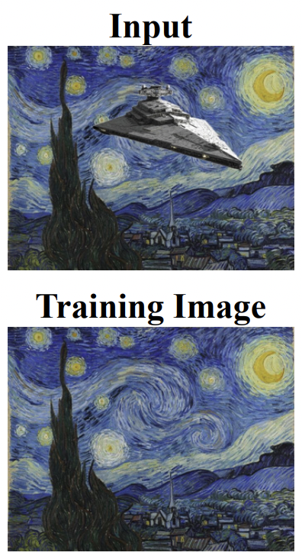
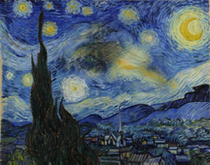
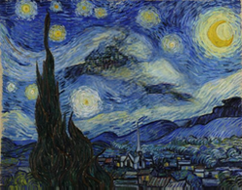
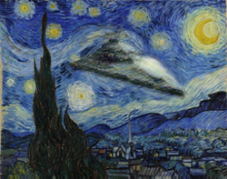
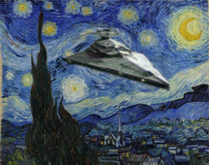
Application: Harmonization
n = 1 (coarsest)
n = 3
n = 5
n = 7 (finest)
Tamar Rott Shaham, Tali Dekel, and Tomer Michaeli. Singan: Learning a generative model from a single natural image. In Computer Vision (ICCV), IEEE International Conference on, 2019.
Notes:
Realistically blend an object with a background image.
We train SinGAN on the background image, and inject a downsampled version of the naively composite at test time. 切。we get blended pictures at different scales
If inject input at small and coarse scale, it results in larger variability in the global structure; while inject at finer scale, only modify texture and finer image features. so Its ability to preserve the global structure of injected image and modify only finer details also has many applications later
our model tailors the pasted object’s texture to match the background, and often preserves its structure
Scales 5 typically lead to good balance between preserving the object’s structure and transferring the background’s texture.

Slide 17
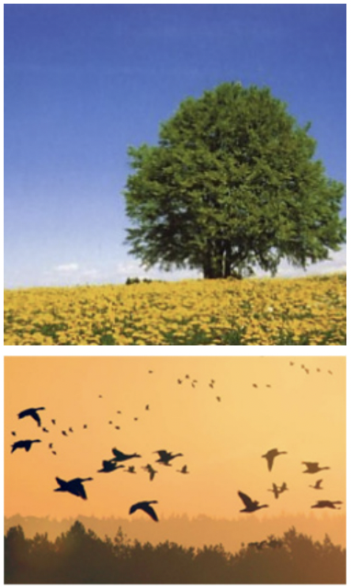
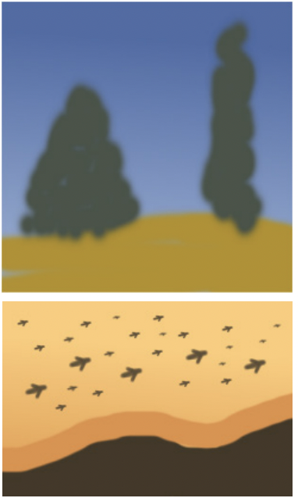
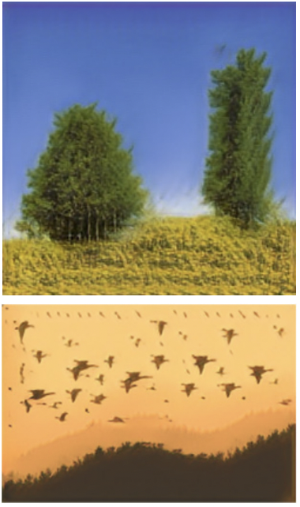
Application: Paint-to-Image
Training Image
Input Paint
SinGAN
Tamar Rott Shaham, Tali Dekel, and Tomer Michaeli. Singan: Learning a generative model from a single natural image. In Computer Vision (ICCV), IEEE International Conference on, 2019.
Notes:
Transfer a clipart painting into a photo-realistic image.
This is done by downsampling the clipart image and injecting it into one of the coarse scales
green spots transfer into trees
the global structure of the two trees is preserved, while texture and high frequency information match the original image

Slide 18
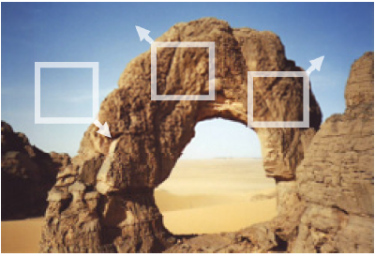

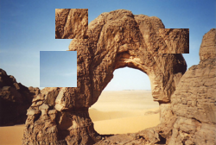
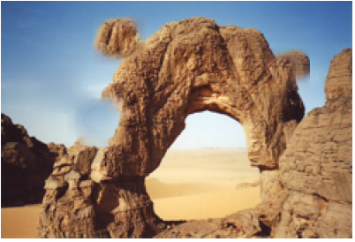
Application: Editing
Training Example
SinGAN (Ours)
Edited Input
Content Aware Move
Tamar Rott Shaham, Tali Dekel, and Tomer Michaeli. Singan: Learning a generative model from a single natural image. In Computer Vision (ICCV), IEEE International Conference on, 2019.
Notes:
Produce a seamless composite in which image regions have been copied and pasted in other locations.
we inject a downsampled version of the composite into one of the coarse scales.
SinGAN re-generates fine textures and seamlessly integrates the pasted parts
producing nicer results than Photoshop’s Content-Aware-Move. It only conduct local changes

Slide 19
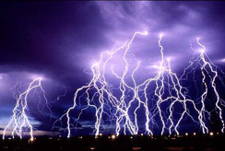
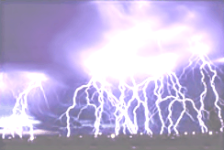
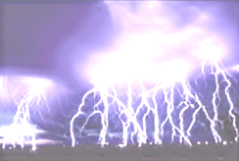
Application: Single Image Animation
Training Image
Video Clip
High Intensity
Tamar Rott Shaham, Tali Dekel, and Tomer Michaeli. Singan: Learning a generative model from a single natural image. In Computer Vision (ICCV), IEEE International Conference on, 2019.
Notes:
Create a short video clip with realistic object motion, from a single input image.
Natural images often contain repetitions, which reveal different “snapshots” of the same dynamic object. The most realistic version is achieved by Gaussian random walk with momentum in the latent space
by changing random walk parameters, we can change animation effect
(e.g. an image of a flock of birds reveals all wing postures of a single bird)
Using SinGAN, we can travel along the manifold of all appearances of the object in the image, thus synthesizing motion from a single image.

Slide 20
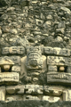
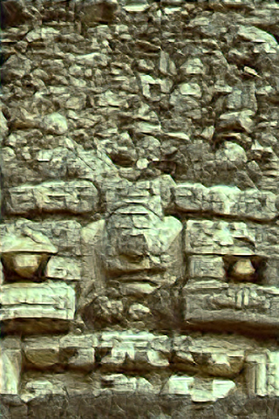
Application: Super-Resolution
Tamar Rott Shaham, Tali Dekel, and Tomer Michaeli. Singan: Learning a generative model from a single natural image. In Computer Vision (ICCV), IEEE International Conference on, 2019.
Notes:
1. Increase the resolution of an input image
2. Since small structures tend to recur across scales of natural scenes, when we add content to the upsampled scales, we can assume all the generators to be the last generators so that we have additional scales and can produce higher-resolution images

Slide 21
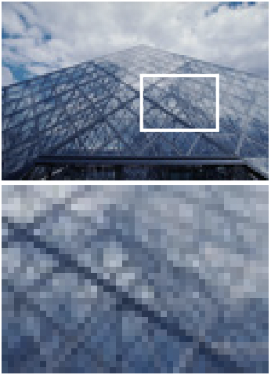
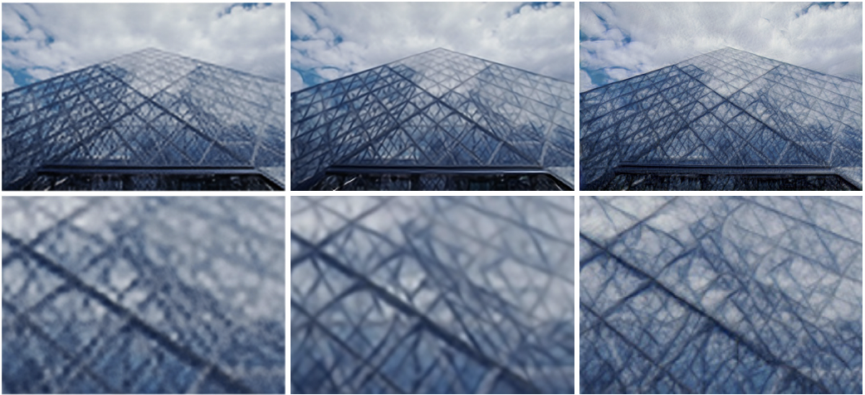
Application: Super-Resolution
Input
DIP
ZSSR
SinGAN (Ours)
Tamar Rott Shaham, Tali Dekel, and Tomer Michaeli. Singan: Learning a generative model from a single natural image. In Computer Vision (ICCV), IEEE International Conference on, 2019.
Notes:
the visual quality of SinGAN was shaper and exceeds that of methods

Slide 22
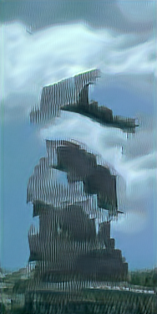
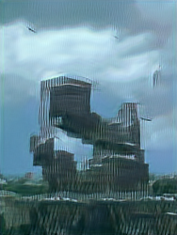
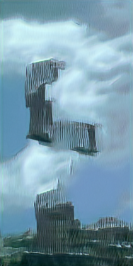
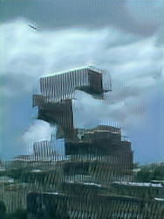

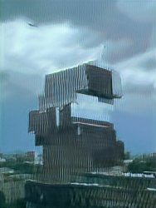
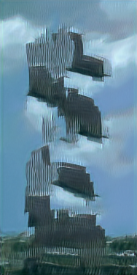




Limitation
Notes:
when the global structure of the image is of high importance
if start at finer scale, it does not modify the structure a lot, like adding more building block on the top

Slide 23
Github Link
https://github.com/Tommzy/CS523Project-SinGAN

Slide 24
Reference
Tamar Rott Shaham, Tali Dekel, and Tomer Michaeli. Singan: Learning a generative model from a single natural image. In Computer Vision (ICCV), IEEE International Conference on, 2019.

Slide 25
QUESTIONS?
Thank you!
Notes:
depict new realistic structures and configuration of objects, while preserving the visual content of the training image

